Slide 1
Height conversion tool
Komal swami
1cr19mca06

Slide 2
features
The following project converts the feet and inches values into centimeters .
It is useful for quick answers .
The user has to insert the feet and inches values to get the centimeter value.

Slide 3
About project
Programming Language : Java is used to develop the features in the backend.
User Interface : Java Swing and AWT libraries are used to develop the UI.

Slide 4
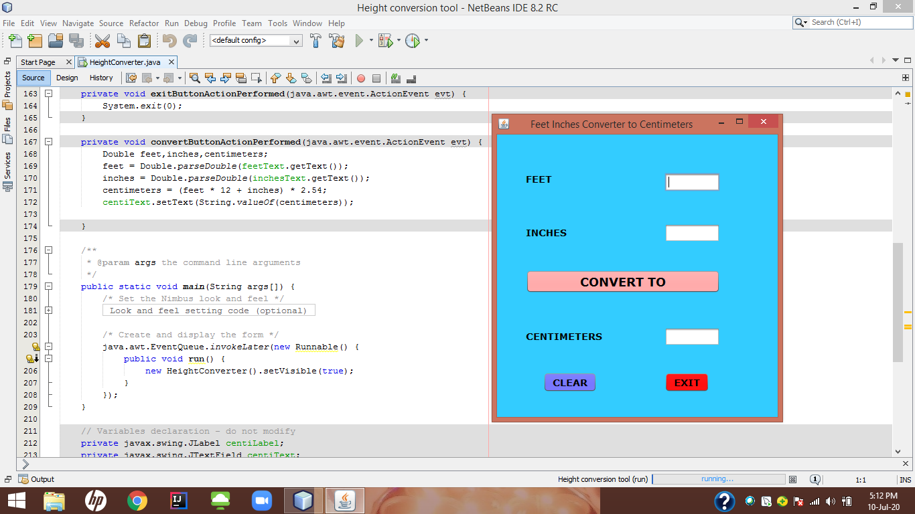
here user will be asked to enter feet and inches value then click on convert to button he will get the required answer.

Slide 5
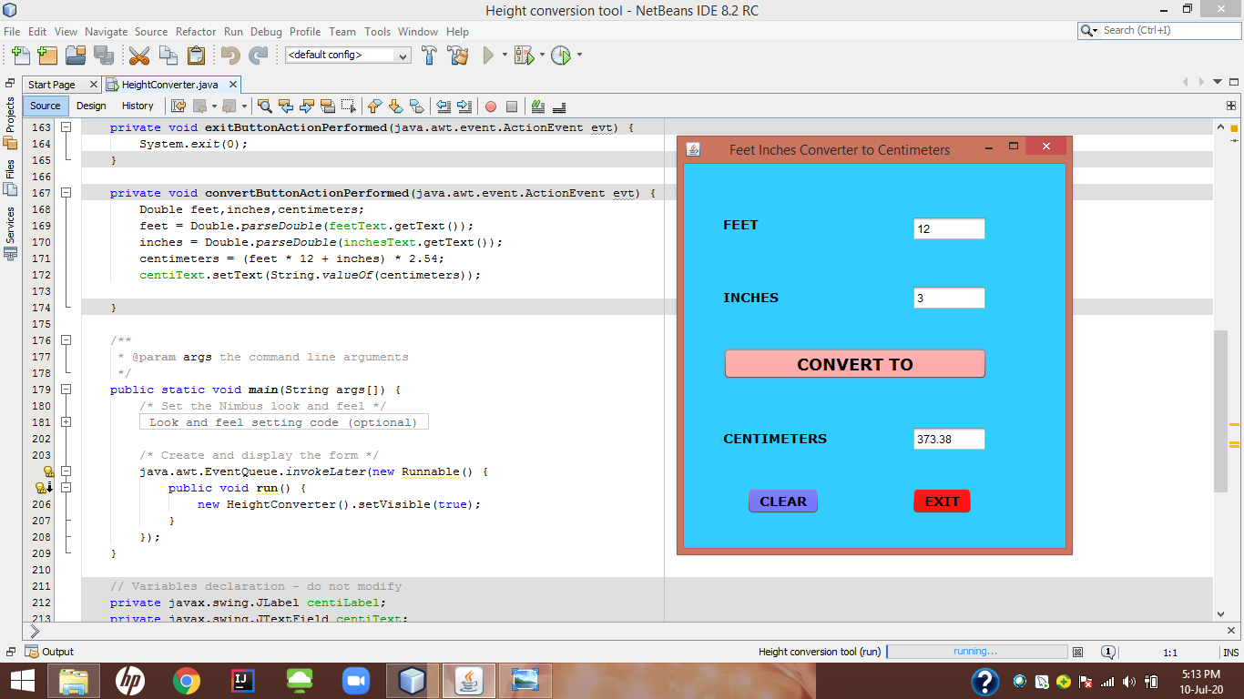
Here the example of the project the user can also clear or exit with the help of clear and exit button.

Slide 6
Thank you

